Slide 1
New York Pizza restaurant market analysis

Slide 2
New pizza restaurant in NYC
A Pizza restaurant located in Naples wants to expand its business internationally and it is considering NYC as its first foreign investment.
It is crucial to choose its location carefully. However, the investor has any idea about NYC Pizza competition and where the main peers are located in the city.
It would be useful to know the venues distribution in the city and cluster all the pizza restaurants to find the best neighborhood to open the new one.

Slide 3
Collect and cleaning NYC Neighborhood dataset
To find and cluster NYC’s pizza venues, first I will use a dataset that contains crucial NYC data, such as Boroughs, Neighborhoods, Latitude and Longitude of the latest one.
A json file is well suited on IBM cloud site, https://cf-courses-data.s3.us.cloud-object-storage.appdomain.cloud/IBMDeveloperSkillsNetwork-DS0701EN-SkillsNetwork/labs/newyork_data.json
The file was tranformed in a more functional pandas dataframe

Slide 4
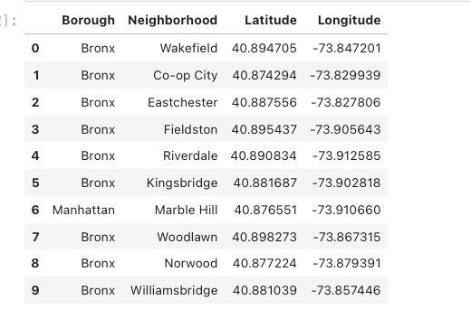
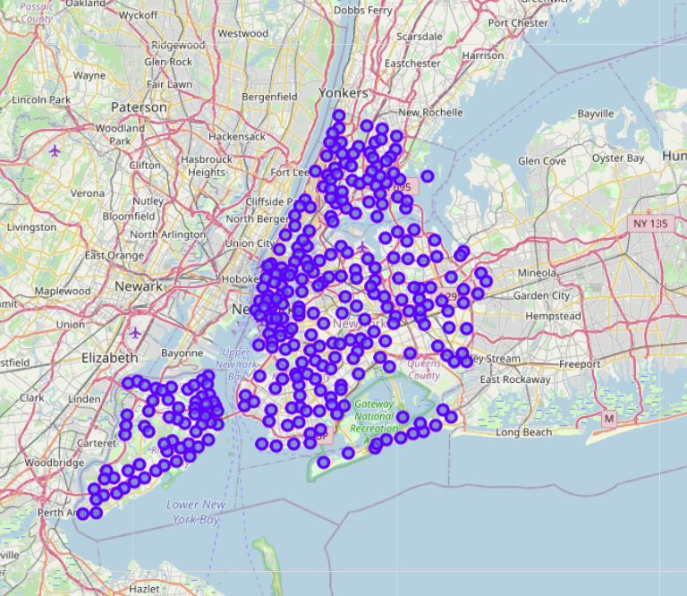
New York City Neighborhoods

Slide 5

Collect all venues in NYC

Slide 6
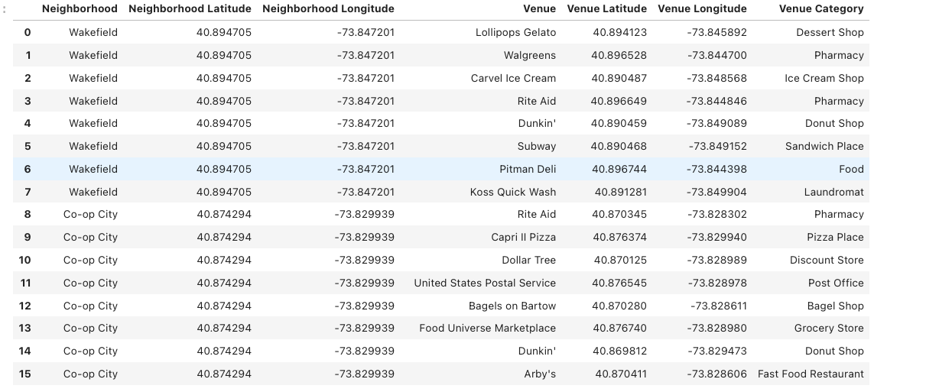
FourSquare is an excellent software to retrieve venues from a city

Slide 7
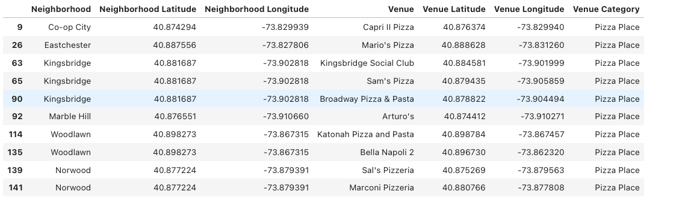
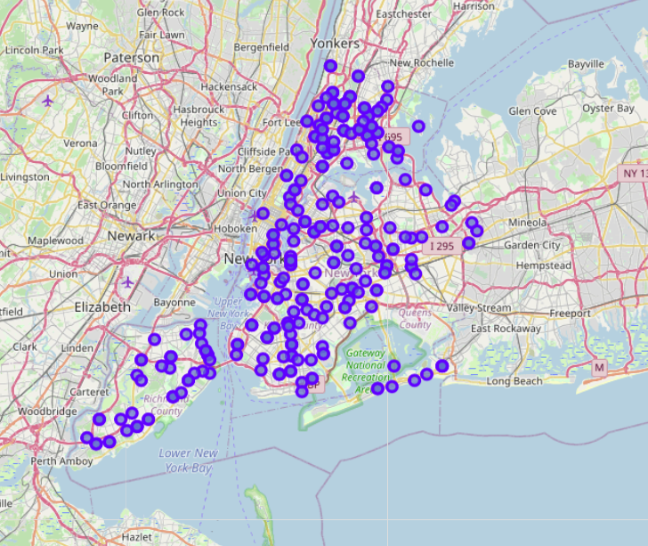
Filtering all venues to just find the Pizza restaurants

Slide 8
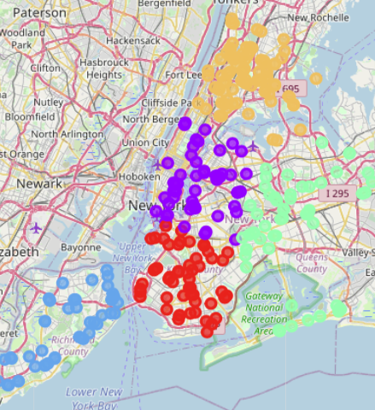
Clustering NYC’s pizza venues

Slide 9
Results and Observations
The model result was pretty predictable, NYC has many Pizza restaurant!
However, it easy to see that their disperion is different for each Neighborhood and many of them might be very attractive to open a new one.
The model is highly liked to FourSquare perfomance. New York City is a very huge city, so it would be good to focus on a specif Borough or group of Neighborhood.
The model is essentially scalable for every city in the world if FourSquare could provide a reliable dataset of Venues.

